Slide 1
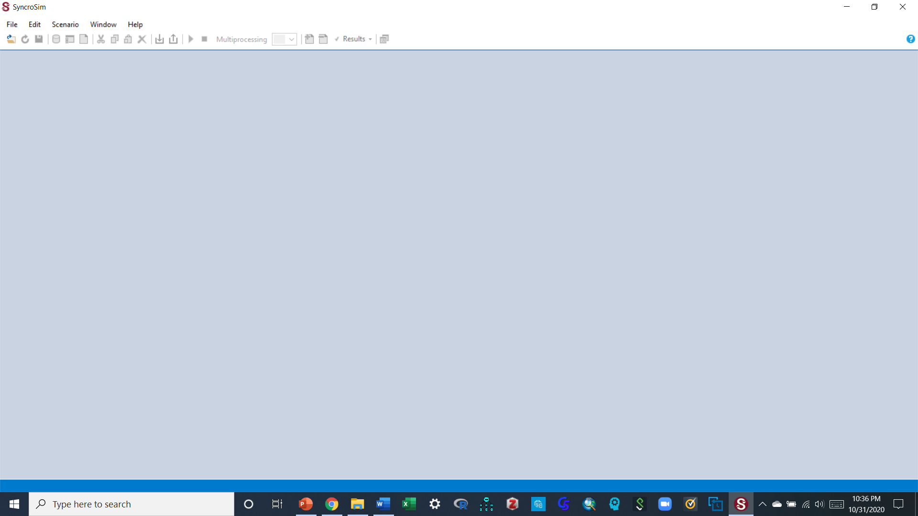
To begin:
Create a folder (on the desktop or in your documents) for this activity and name it
Open a new word document and save it in the folder. This is where you will paste all your output and respond to questions, and that you will submit for this assignment. Keep saving this document frequently so you do not lose your work.
Download all the files provided for this activity, and save them on a folder on your desktop or where you can access them to work with during this activity
To get started, open SyncroSim (If more than one version appears, its ok to just select one).
Your workspace should look something similar to the screen below

Slide 2
Check if the software is updated, so it can accept a scenario file that you will bring in to work with
In order for your SyncroSim workspace to accept the files you are going to bring in (libraries), you need to first check if all of the necessary packages are already installed in it and ready to go, OR if you need to install them in case they are not already there.
To do this, look at the “software installation & updating” supplemental material) and follow the steps in there to accomplish this task
Once all that is done, you should be ready to start your work now. Go to the next slide

Slide 3
Part 1: Understanding the syncrosim modeling environment and displaying normal succession classes in your ecosystem

Slide 4
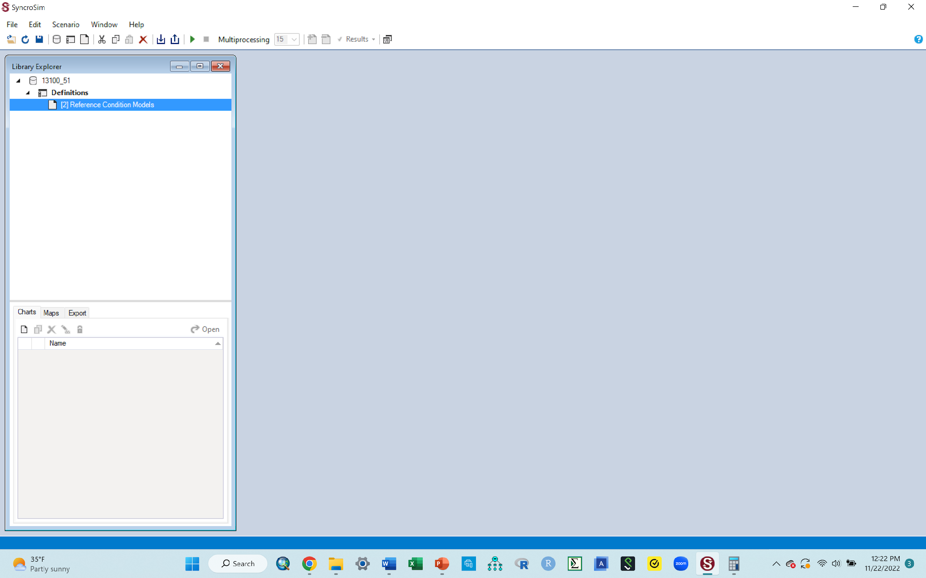
A. Bring into the workspace the “13100.51.ssim” library file
Go to File > Open. You’ll have to navigate to where you have the “13100.51.ssim” file to get it.
If additional pop-up boxes come up asking you to convert or update the file you just called in, follow the instructions on that box to click “apply” or “OK” to convert it to the latest version
Once the file is called in correctly, the workspace should look something similar to the one below
Reminder: Once you start conducting the exercises of this lab in SyncroSim, get in the habit of frequently clicking the save button in the panel at the top so you do not lose what you have done, incase something happens!
Go to the next slide

Slide 5
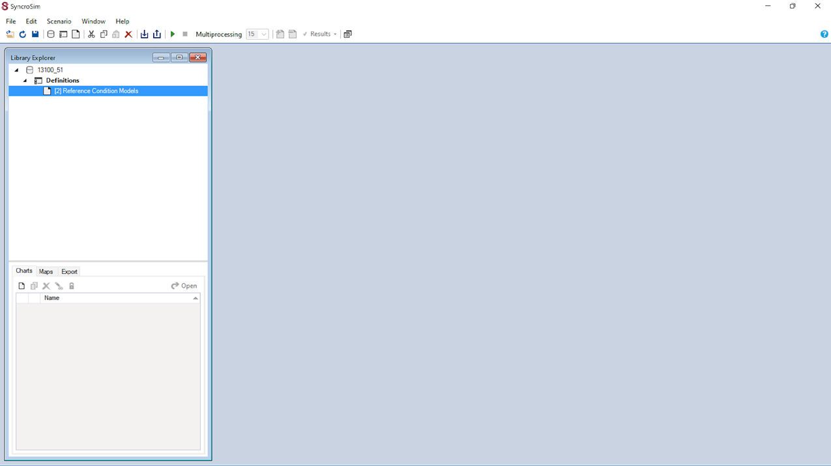
A. Understanding the library and workspace
The 13100.51.ssm file that you called into the workspace is called a library file. A library is a file that stores store all your model inputs and outputs (has the things that you will need to work on). Think of a library like the ecosystem that you want to work with, say a type of forest
Once you start working on a given library, you can create various projects and name them appropriately. In this example, a project called “Definitions” has been created for you from the library. Think of a project as working on say invasive species one time, and another time working on fire. The work you are doing on invasive species is one project, the work on fire is another project, both of which can be done on the one library (your forest)

Slide 6

A. Understanding the library and workspace
Once you have a project, then you can work on various scenarios within that project. In this example, the first scenario called “[2]Reference condition models” has been made for you. This first one is the original scenario. For example, if your project is say fire, you can work on various scenarios of fire by changing the parameters of the fire during your modeling process to examine the impact of different fire severities, so that scenario 1 is the original ([2]Reference condition models), scenario 2 could be fire that returns after 5 yrs, and scenario 3 is fire that returns after 10 yrs.
For this activity, the ecosystem (library, the 13100.51.ssim file) you are working with is a North-Central Interior Dry-Mesic Oak Forest and Woodland. A document with background information about this ecosystem is provided for you as part of the supplemental materials.

Slide 7

B. Delete unwanted items in your workspace, if there are any
Sometimes, your workspace (the screen below) can have other scenarios and their results or even other libraries and projects. This maybe be because someone had used syncrosim in the computer and saved their output. When syncrosim is opened again, all of the previous saved items show up on the screen. You need to delete them in order to have a clean start.
For purposes of making the activity simple and straightforward, your workspace should have the only the 13100.51.ssm library, the Definitions project and the “[2]Reference condition models” scenario, similar to the image below.
If there are no other files in your workspace, you are good to go, just go to the next slide to continue
If by some chance you have additional items in the workspace, do the following
Right click each of these extra items and click delete to remove them

Slide 8
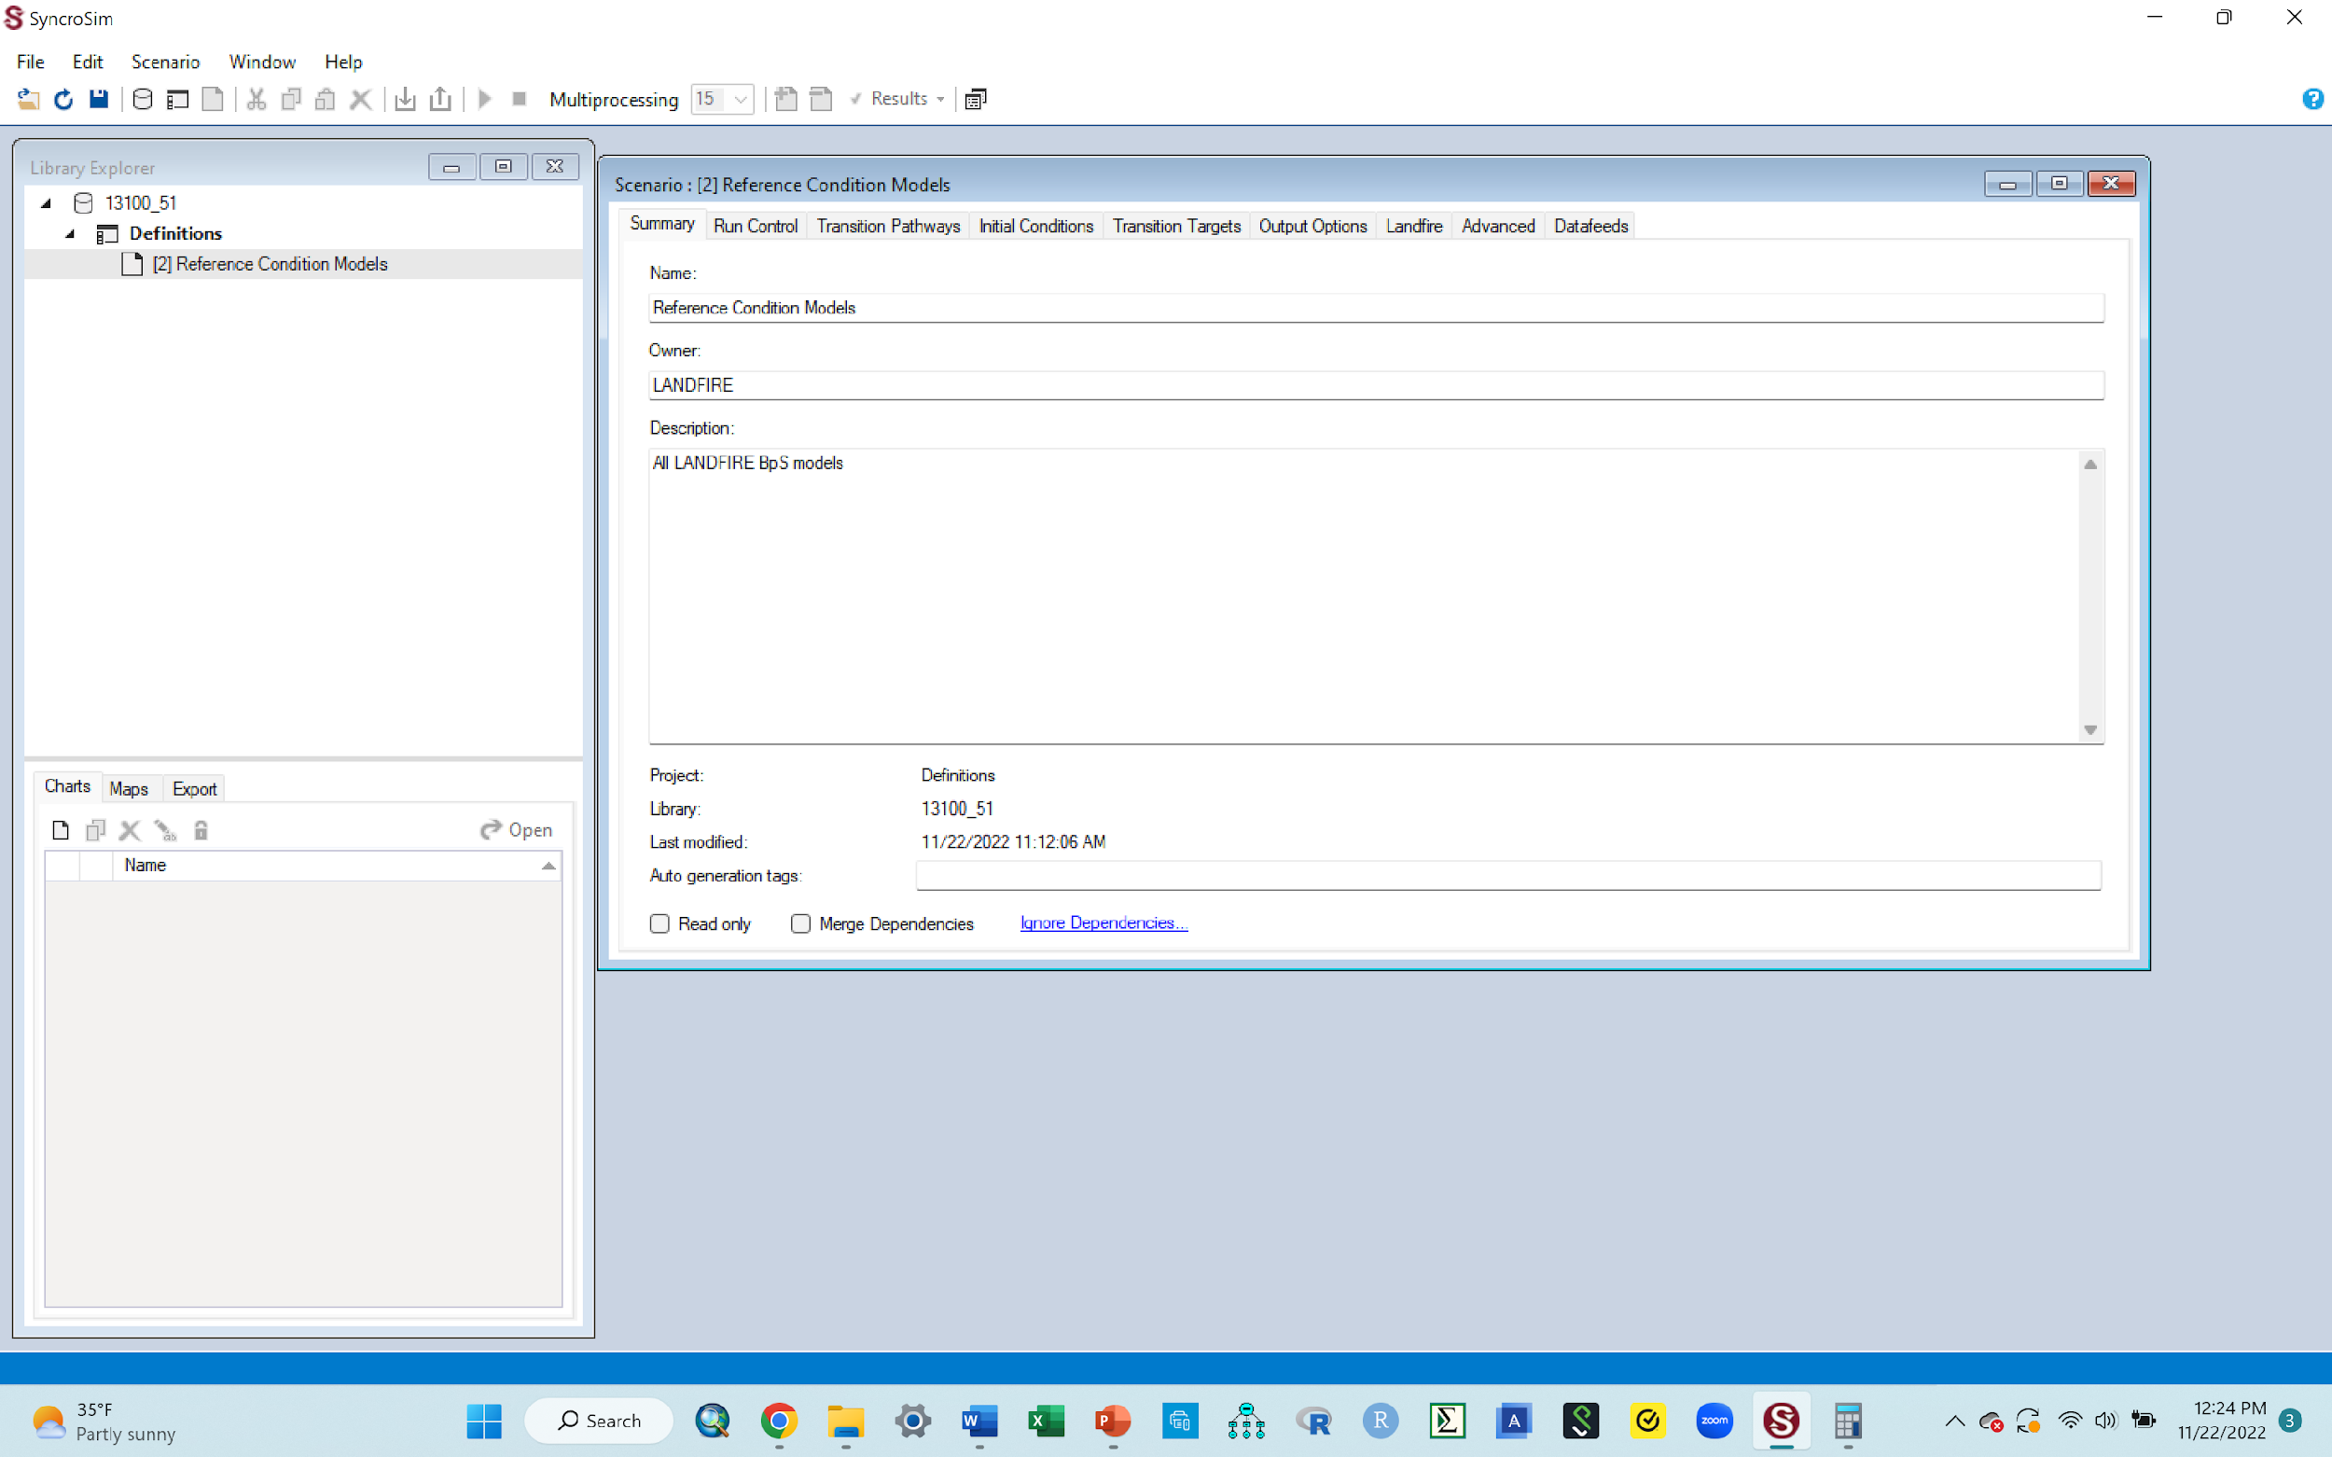
Make your screen look like this, then double click on “All Models”
C. Bringing up the scenario pane
Remember, our original scenario was the “[2]Reference condition models”
We want to open and examine itnow. Its contents will be contained in a pane called the scenario pane.
Bring up the scenario pane for this scenario, by double clicking it (double click the “[2]Reference condition models”)
Once the pane is up, you can 1) move the scenario pane around to rearrange the tables so they are next to each other, OR 2) you can click the “window” tab at the top and select “Arrange all”
You can also expand the scenario window downwards (or sideways) to help see everything in the window
When done, your window should look similar to the one below, for option 1 above

Slide 9
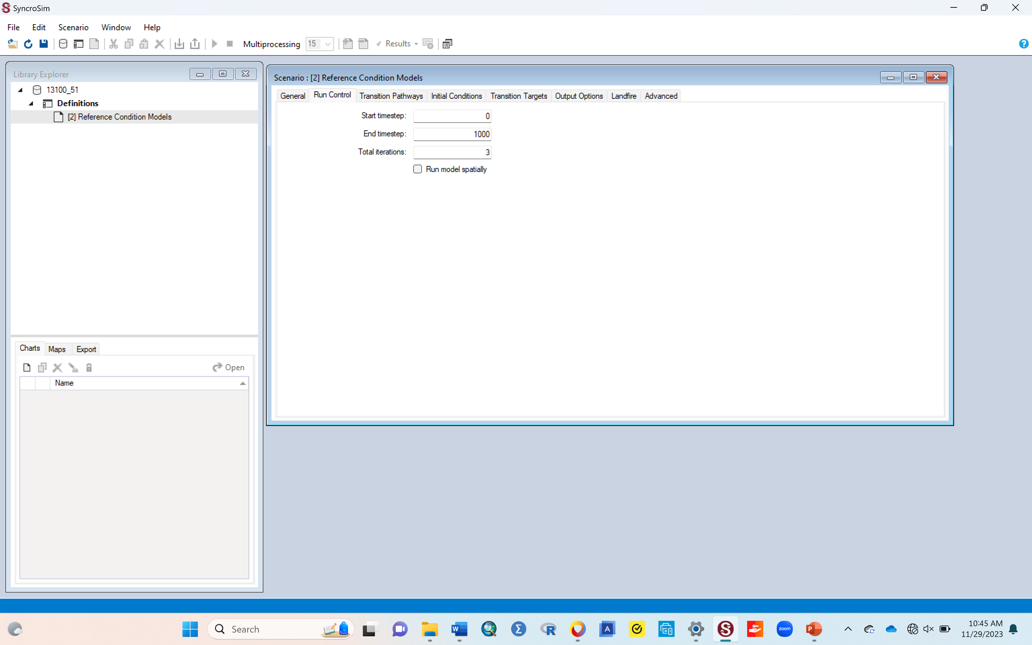
C. Bringing up the scenario pane
In the scenario pane, click the “Run control” tab at the top of the scenario pane.
The “start timestep” line should have zero in the box
The “End timestep” line should have 1000 in the box. If it doesn’t, type in 1000 to replace what's there
The “Total Iterations line” line should have 3 in the box. If it doesn’t, type in 3 to replace what's there. We are telling it that whenever we run the model, we want it to do 3 iterations of the run. We selected 3 to save time since the more iterations you put, the slower the run is likely to be.
The meanings of these terms are explained in the glossary document that is among the supplemental materials provided
Click the save button. You must do this to save the changes you made, otherwise they will be lost
When done, your window should look similar to the one below

Slide 10
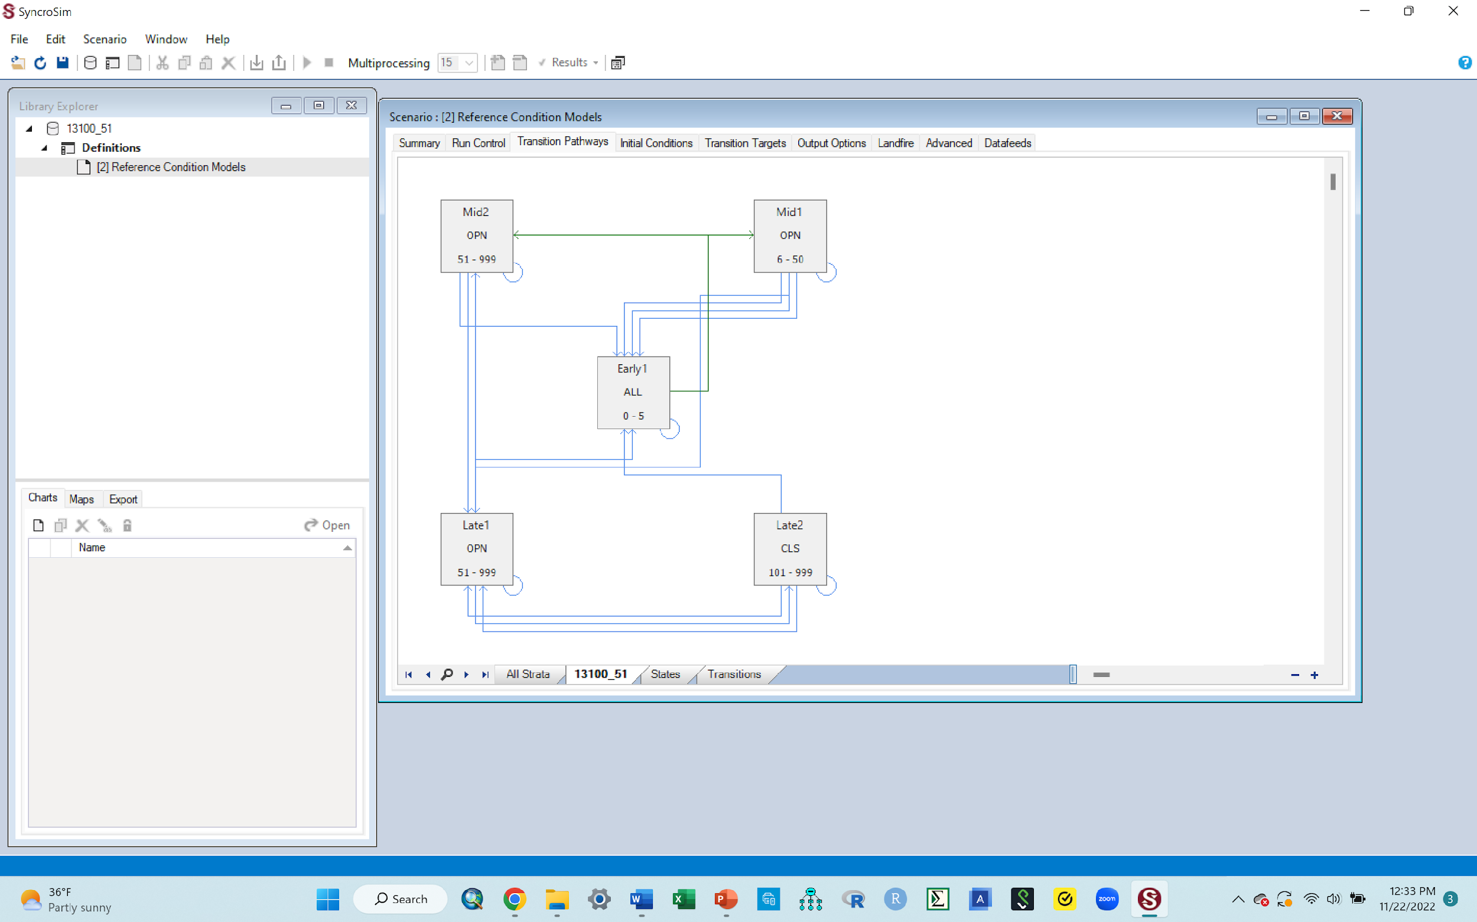
D. Display the normal/current succession classes for your ecosystem
We now want to see the different successional classes that exist in this ecosystem. These classes can also be viewed by clicking the “landfire” tab at the top of the pane and in the background document provided for this ecosystem, where each of the classes are also explained
To display the classes, click the “Transition Pathways” tab at the top of this pane. They will be shown in boxes, with lines connecting the boxes. Extend the bottom boundary of this pane downward so you can see all the classes in the diagram
The boxes are the successional stages, also called “state classes”, and the lines connecting them are the paths that they would take when moving from one class to the other, also called “transitions”.
In this original diagram, the classes shown are the succession classes that exist in this ecosystem under normal succession, i.e., with no external disturbances introduced yet
When done, your window should look like similar to the one below

Slide 11
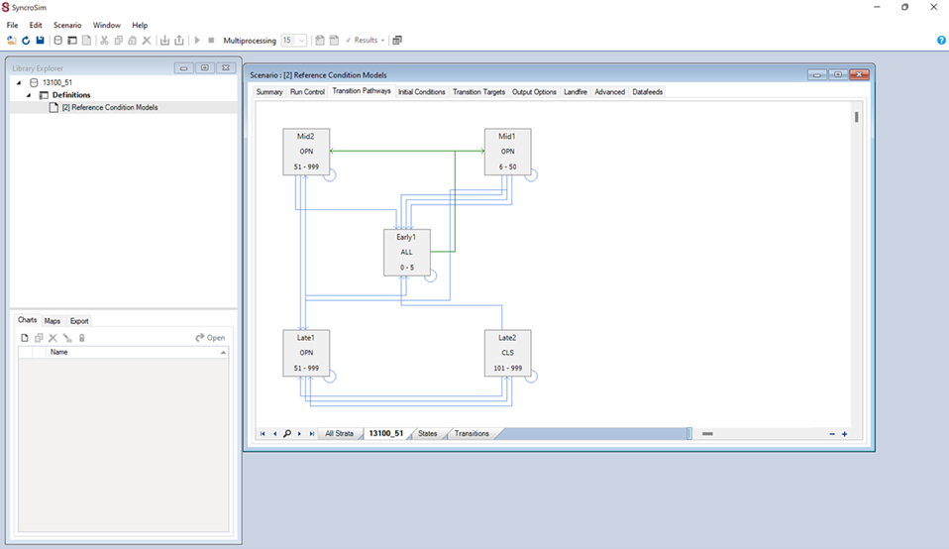
Assignment # 1:
Take a screen shot image of the transition pathways diagram, paste it to your word document and caption it as “Figure 1. Normal succession”.
Once you paste, it helps to crop it to leave only the diagram (the part inside the dotted box below). This makes it so that you do not submit an image that shows your whole screen

Slide 12

E. Explanation: what the boxes in the diagram and links connecting them mean
In the pathway diagram:
Each box represents a succession stage in the system (also called State classes). The general succession classes we know in ecology are Early, Mid, Late. But for this activity, a gradient of these state classes(subdivisions) e.g., Mid 1, Mid 2 are included. That is why you have both the Mid and Late state classes have two options each. The number and kinds of state classes will differ depending on the ecosystem (library) you are working with.
The green lines connecting these boxes are the normal succession pathways the system goes through from one stage to another, with no external disturbance (they are typically green).
The blue lines connecting these boxes are the succession pathways the system goes through from one stage to another when there is some intervening disturbance (they are typically blue).
If you introduce a disturbance to a system, it is the blue pathways that are affected and where movement happens

Slide 13
E. Explanation: Understanding the state classes and the linkages
In the pathway diagram
Each box has text inside it that tells you the name of the state class (e.g., early 1), the nature of the canopy (ALL, OPN or CLS), and how many years it lasts in that state class before moving to the next state class (e.g., 0-5)
The ecosystem you are working for this activity has 5 successional stages: Early 1 (ALL), Mid 1 (OPN), Mid 2 (OPN), Late 1 (OPN) and Late 2 (CLS)
Early 1 means early succession stage, and in our case here, we only have one stage of this in this ecosystem; some ecosystem might have early 1 and early 2, which are just 2 gradients of the early succession stage, with early 1 being more of the initial early succession stage than the early 2 which would be a more developed/mature early succession stage. The same logic applies to all the other stages. In this case, you have 2 mid succession stages (mid 1 and mid 2) and 2 late succession stages (late 1 and late 2)
The letters describe the structure of the canopy: Canopy is open (OPN), canopy is closed (CLS), or canopy has a mix of some open patches and some closed patches (ALL, meaning mixed structure).
The numbers inside the box gives the range of time in years the succession stage can remains in that stage before it moves to the next stage, under normal succession (i.e., with no intervening disturbance)
For example: in this diagram, the stage Early 1 has ALL and 0-5. This means that this stage of early succession has a mixed structure canopy (ALL) and will typically last in this stage (early 1) for between 0 and 5 yrs, under normal conditions with no abnormal external disturbances (i.e., naturally).
After those 5 yrs, it should be expected to transition into the next stage, Mid 1, which will have a relatively open canopy (OPN) and last in that stage between 6 and 50 yrs etc
A reminder that the details of each of these classes can be viewed using the “landfire” tab in the scenario pane, or by reading the background information document provided as part of the supplemental materials.

Slide 14
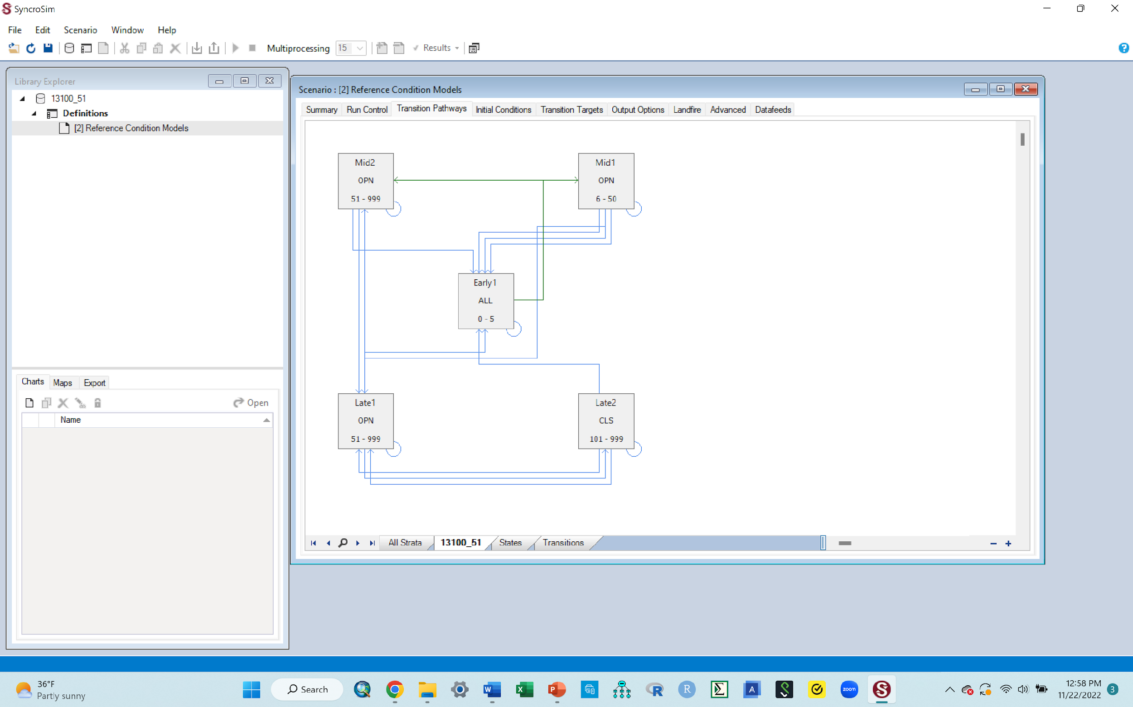
F. Now, we want to run the model to produce a graph showing how much of the landscape is classified under the different state classes (succession stages) previously described.
While you still have the scenario pane open, click the “Run Control” tab at the top & ensure the numbers you entered in those boxes are still there (0, 1000 and 3).
Exit the scenario pane (the one that you have been looking at) by clicking the red X button at the top right corner of this window, also shown in the image below
Go to next slide to see how your window should when done

Slide 15

F. Now, we want to run the model to produce a graph showing how much of the landscape is classified under the different state classes (succession stages) previously described
Your window should now look similar to the one below

Slide 16
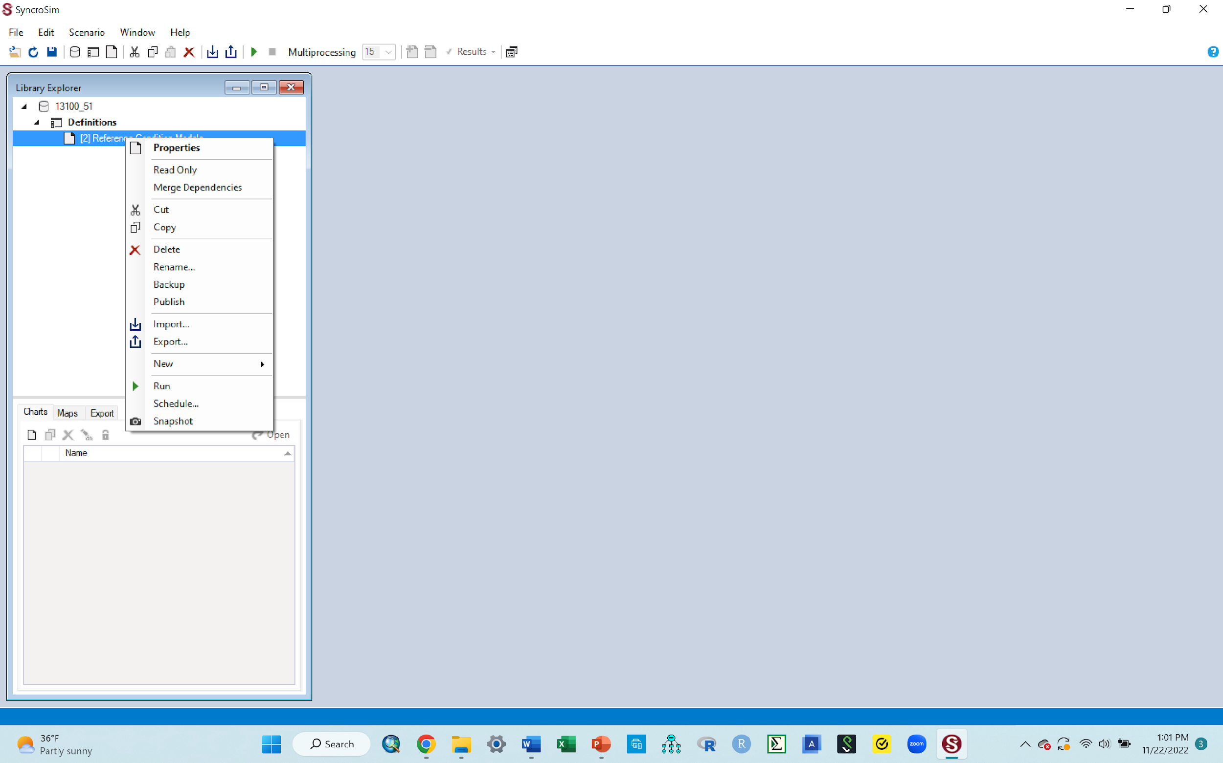
G. Run your model (for normal succession i.e., with no introduced disturbance)
We want to run the model for our original scenario (the “[2]Reference condition models”) so we can produce a graph showing the proportions of the state classes i.e., how much of this ecosystem is made up of each of these classes
To do that, click the “[2]Reference condition models” once to highlight it (it will have a blue color over it once highlighted
Then right click it, and in the resulting box, click the “run” tab that’s towards the bottom of that box (shown with the arrow in the image below). The run tab is typically a green arrow that points to the right
Going forward, right clicking your scenario and them selecting this “run” arrow, is how you run a model for any scenario
Once you click the run tab, a run monitor window will pop up to show progress and the run should complete in no time (since we asked it to do only 3 iterations of the run). The run should go fast, almost like a flash.
Go to next slide to see what your window should look like when done

Slide 17
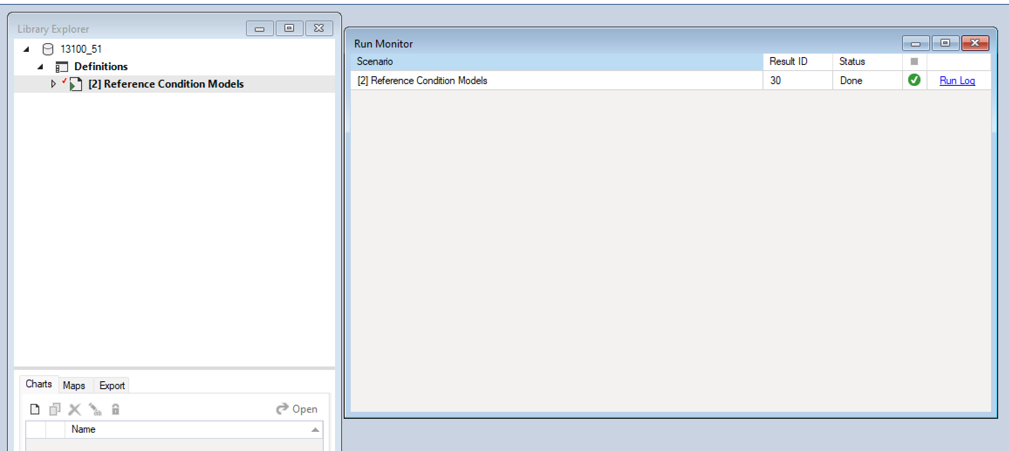
G. Run the model (for normal succession i.e., with no introduced disturbance)
When the quick run is done, your run monitor window should look similar to the one below
The blue text (says run log) and the box with a green check in it indicates that the model ran successfully with no errors during the run.
Go to next slide

Slide 18
H. Exiting the run monitor window
You have just run a model of the original scenario, and all that is left is to display your results.
Before doing the display, you need to exit the run monitor window. To do that, click the red X to the top right corner of the run monitor window (shown by the arrow below)
Go to next slide

Slide 19

H. Exiting the run monitor window
Your workspace should now look similar to the one below
Notice that the original scenario “[2]Reference condition models” now has a little arrow pointing to it (shown by the arrow). That arrow tells you that the model for this library has run and generated results.
Go to the next slide to see the line of results that this arrow indicates

Slide 20
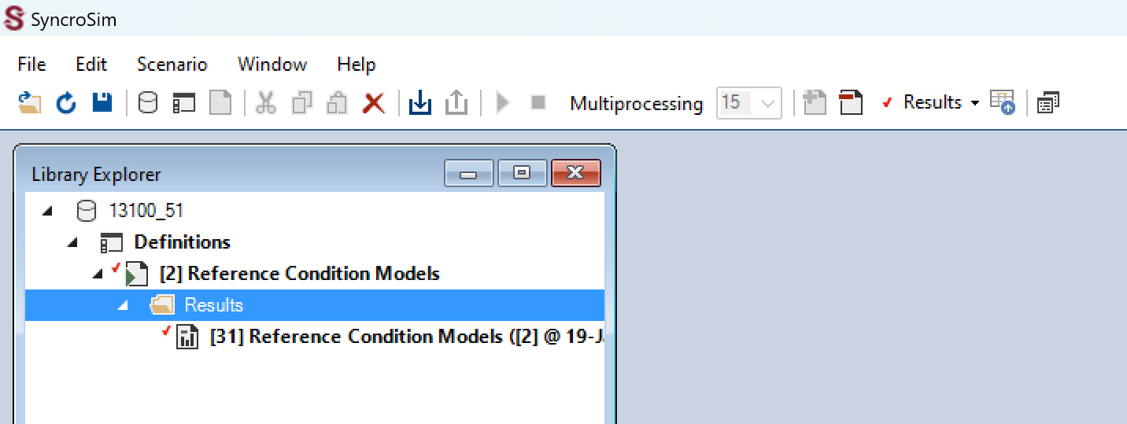
I. Viewing the result lines in the library explorer pane
If you click the little arrow pointing to the “[2]Reference condition models” scenario, you will see “results” below it.
The result will also have an arrow pointing to it, and if you click that arrow, it will show a line of results
See below for what it looks like when you click these two sets of arrows
Note that to hide the results, you just need to click the two arrows again, the one pointing to the results, and the one pointing to scenario

Slide 21
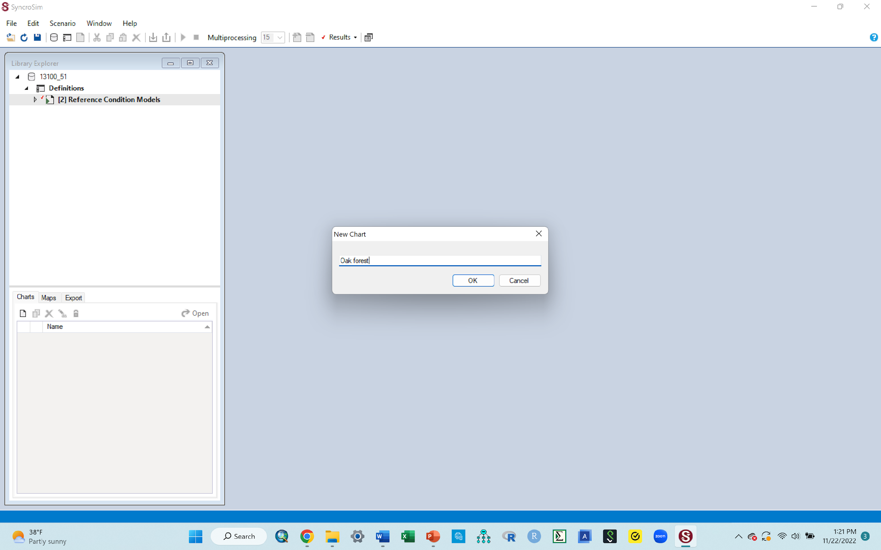
J. Next, you want to produce in a graph, the results of the model you just ran
Because you plan to make a graph, which in this activity is classified as a chart, you need to create a new chart and name it, as follows
Click the “New Chart” button (shown by the arrow in the image below). A little chart box with a “chart1” written inside it will come up
Rename the chart by replacing the “Chart1” with “Oak forest” (just type that in there)
click Ok and a new window will come up.
Go to next slide to see this new window
Note: sometimes you might get an error message once you hit OK above. This is likely a computer specific glitch common with some personal computers, and in many instances, using a different computer can help. If you run into this problem, it is preferable to use a university computer where syncrosim is likely to have been installed correctly, rather than a personal computer.

Slide 22
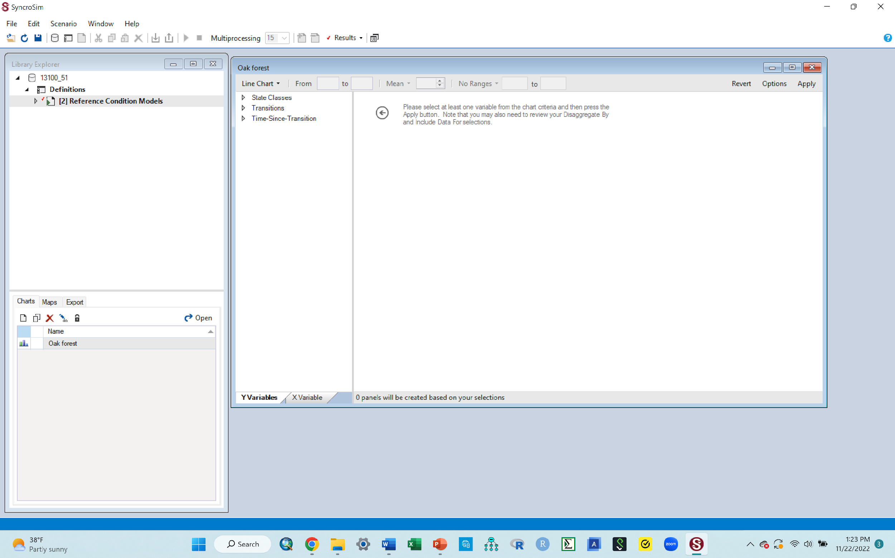
J. Next, you want to produce in a graph, the results of the model you just ran
The window below shows what should pop up after the previous step
Note: The new chart box that pops up will likely be overlaying the library explorer pane that is to the left. To get the new chart box and the library explorer pane to appear side by side, just drag the chart box to the open blue space to the right, so it's sitting next to the library explorer pane, similar to the ones show in the image below
When done arranging them go to the next slide to continue

Slide 23

J. Next, you want to produce in a graph, the results of the model you just ran
Before you get a graph, you need to tell the graph a few more things that you would like it to show
First, you want to make sure the graph produced is a bar graph, not a line graph
Click the dropdown under “line chart” and select “column chart” (area highlighted in the image below).
This ensures that you will have each succession stage presented as a bar graph, not as line.
If you do not select the column option here, your graph will have lines instead and you don’t want that for this practice activity.
When done with that, go to the next slide to see how the screen should look

Slide 24
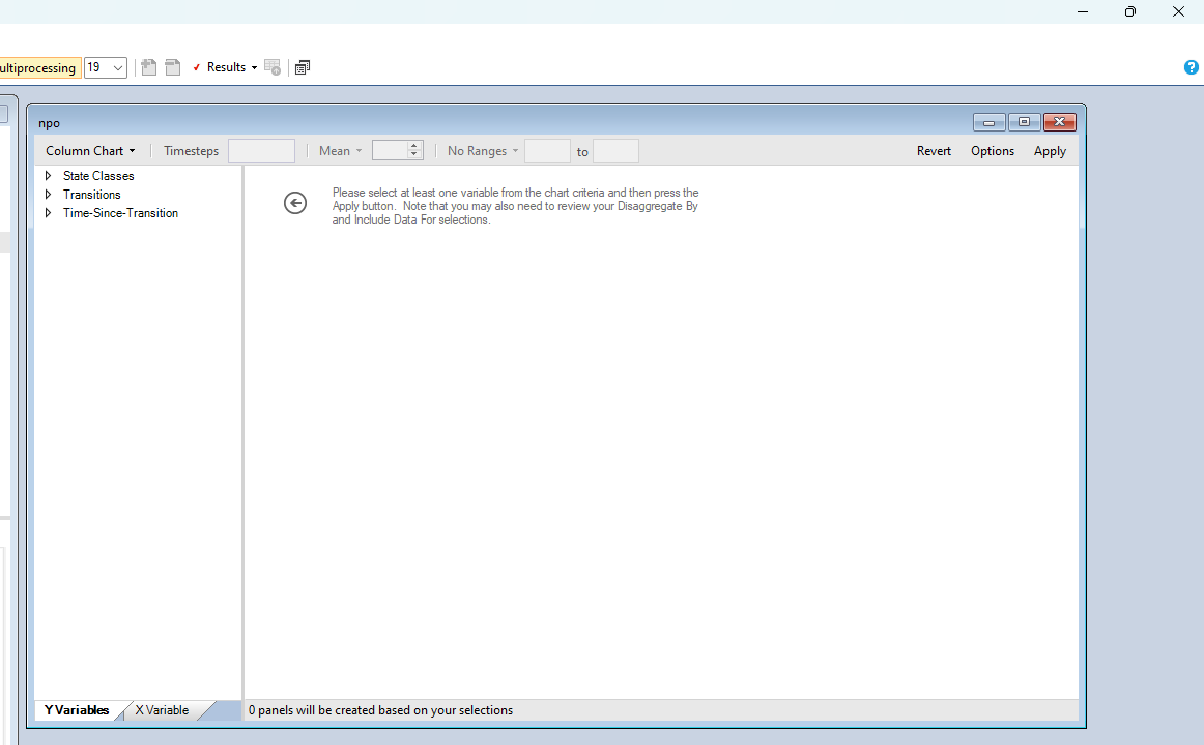
J. Next, you want to produce in a graph, the results of the model you just ran
Your screen should now look similar to the image below
You now have 3 tabs (shown in the circled area in the image below): State classes, Transitions, and time since transitions. Each with a dropdown/pointed arrow before it
Next, you are going to make selections using the dropdowns/arrows for each of the 3 tabs
Go to next slide to do that

Slide 25
J. Next, you want to produce in a graph, the results of the model you just ran
Your selections will go as follows
Under state classes: select “proportion”
Under disaggregate by: select “state class”. While here, ensure that all the other boxes listed there are unchecked i.e., are empty with no check mark.
Under include data for: click “ state Class” , which brings up all state classes, and all of them have check marks.
You want to uncheck all of them, so you can manually check the classes in your model ecosystem i.e., the ones you had in your transition pathways diagram. The classes are also given below.
To do that:
Click the very first box that says All. This will uncheck all classes
Then manually check the boxes for these classes
Early 1:all
Mid1: OPN
Mid2:OPN
Late1:OPN
Later2: CLS
Note: Double check your check marks to ensure they are in the correct classes. Selecting the correct classes is critical for what you will get
When done, go to next slide to see what your screen should look like

Slide 26
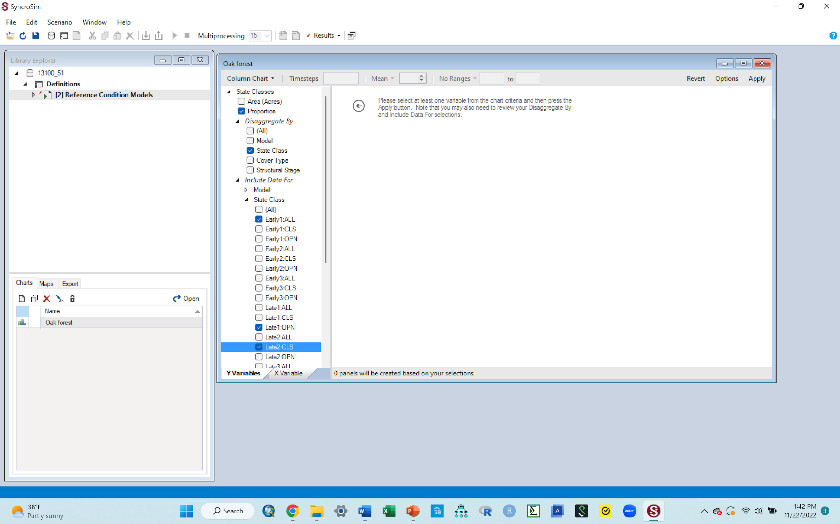
J. Next, you want to produce in a graph, the results of the model you just ran
You resulting screen should look similar to the image below.
Some of the classes might be cut out in this image just because only so much could be fitted in.
Go to next slide to continue with your steps

Slide 27
J. Next, you want to produce in a graph, the results of the model you just ran
Click the “apply” tab that is at the top right corner of the box you are working with (pointed to below). This step is what will produce a graph, so do not be surprised if one pops up!
You will get a bar graph!!
The graph may pop up on the screen by default, OR
You may have to double click the “oak forest” chart that you made in the chart area.
Whichever works to display the graph
Go to next slide to see what such a graph should look like

Slide 28
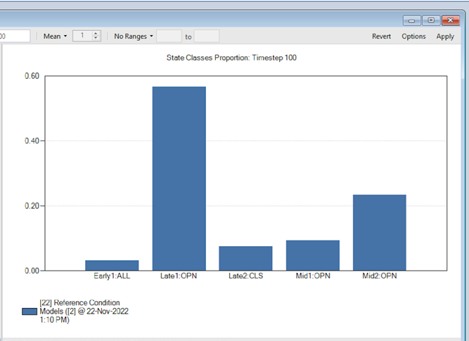
K. A bar graph!! Yaay!!
The bars in the graph above represent the proportion (in %) of this ecosystem, that can be categorized under each of the 5 state classes (successions stages). That means that if say you walked into this normal functioning healthy forest, there will be parts of the vegetation in it (a certain %) that can be classified as Early 1 All, another as Mid 1 Open, etc
This is what this modeling used to show: How much of your ecosystem falls under each of the succession stages under normal succession. Later, You will see how a disturbance can change the proportions of these successional stages (changing the heights of each bar)

Slide 29
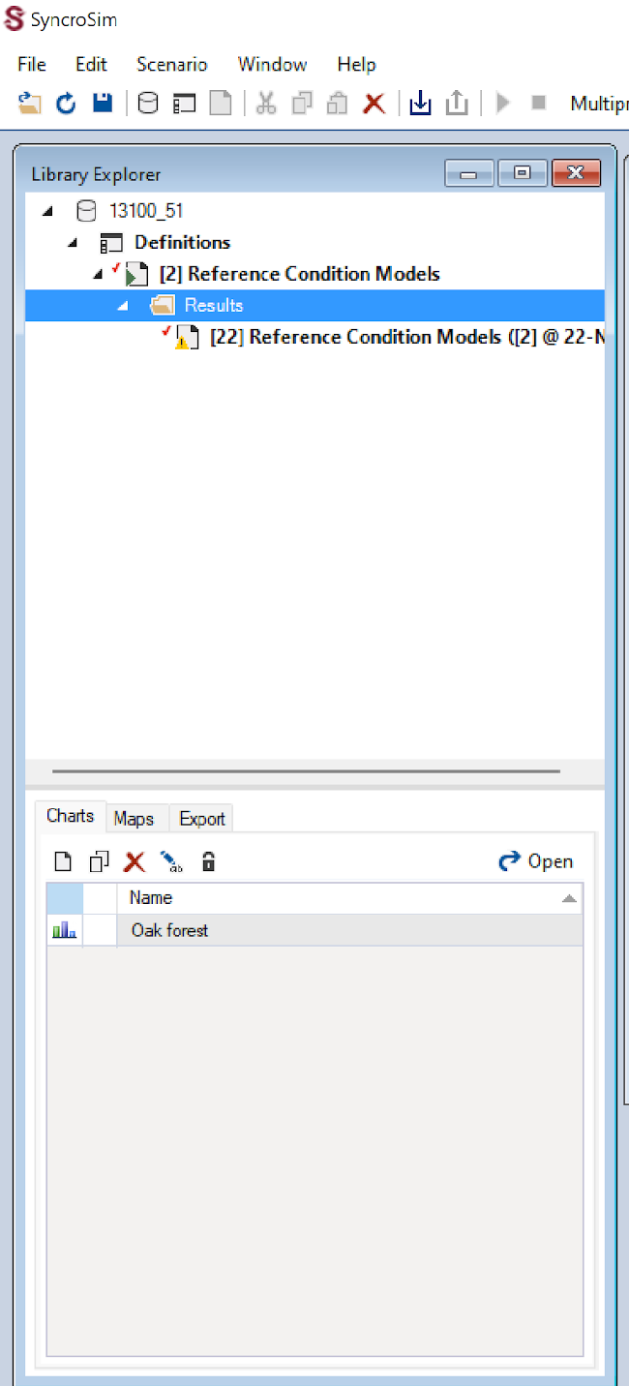
K. A few things to check regarding your graph and the workspace
Note:
This first graph should have one bar for each of your state classes (5 bars total, one for each class)
If for some reason, you end up with more than one bar for each class, do the following to correct it
Look at the library explorer section where you have the original scenario, the “[2]Reference condition models” (area circled in red in this image)
Click the dropdown arrow next to the “[2]Reference condition models” scenario. That will bring up “results” under it
Click the dropdown arrow next to the “results” and that will bring up the result lines for all the scenarios showing up on your graph
If you have more than one line of results there, starting with the top one and going down, right click each and click delete, leaving only the last one, which should be the most recent output
You should just have one line of result under the “results” as seen in the image here

Slide 30
Copy your bar graph to your word document
Assignment # 2: Put cursor in middle of the graph, right click, select copy to clipboard, then paste in your word document. Caption it as Figure 2. Oak forest normal
Be sure you crop the image if necessary
Once you have copied the graph to your word doc, you are done with the graph in your modeling window and can delete it so you can clear that window for your next scenario modeling activity.
To delete the bar graph, click the red X tab that is at the top right corner in the pane, just as you have done before

Slide 31
Part 2: Introducing an external disturbance to your ecosystem and modeling its impact on the state classes (succession stages)

Slide 32
L. Next, we want to introduce an external disturbance and model its effects on the succession of this system
You see, many of our ecosystems are not natural (healthy) anymore, because sooner or later, there is bound to be some external (and often unnatural) disturbance that impacts them.
So, while we would love for things to remain as they are (stay with the graph we just made assuming that is healthy), that is not reality
This means that in ecology, we always need to stay ahead of the problem, by modeling effects of such disturbances on an ecosystem, so we can forecast what it is likely to do to the ecosystem, before it happens.
For example, if say the bar for the early 1 succession class in the graph you just made says the forest right now has 2% area classified as early succession 1, we want to introduce a hypothetical disturbance (like an insect invasion) into this forest, and we want to see if after running that disturbance scenario, if the early one succession class will still be 2% or if the proportion of that succession class will be reduced or increased.
If asked to do another scenario with a disturbance impacting your ecosystem, the steps given below are how to do it.

Slide 33
L. Some explanations to help set the stage for this next part
So far, you have been working with one scenario (“[2]Reference condition models” ). This scenario is the original/baseline scenario.
So, you use the word “normal” here because this is what the forest looks like currently, before it experiences any external disturbances. This is your baseline for comparisons later.
When you start this modeling activity for the first time (when you start syncrosim and call in the library), you need to first run this original scenario (do all the steps you have been doing so far), so you can have these original bars.
In the following section, we will be introducing a disturbance to this ecosystem (create a new scenario).
You will need to run that scenario too and produce a new graph
That new graph will have 2 bars per state class. One bar will be for the original scenario (the one you just ran, its typically blue), and a second bar for the introduced disturbance (the new scenario, its typically red)
The new bars in those graphs (the red ones) will be representing the impact of that disturbance. As such, to examine any change that a disturbance causes, we will be comparing the height of the bars for the introduced disturbance (the red ones) to the height of the bars for the original scenario (the ones you just made).
If you do not run the original scenario the first time, but instead go straight to running your disturbance scenario, you will not have bars for the original scenario to compare your disturbance one to.
However, after running the original the first time, you can just keep running your new disturbance scenarios without having to re-run the original scenario, because syncrosim remember that you already ran the original, and it will always show the original bars along with your new disturbance bars

Slide 34
M. First, to introduce a new disturbance, you need to create a new scenario from the original one, that you can then apply this disturbance to.
Some explanation first, do not do anything, just read this:
Remember that the “[2]Reference condition models”) was your original scenario
Creating a new scenario basically means you make a copy of this original scenario.
Making a copy of this scenario will produce a new scenario under it
Then you will need to give your newly created scenario a name
Then you will work with this new scenario to produce a new bar graph of results
Once you create a new scenario, and once you are done running and producing a graph with it, and copied the graph to your word document, before embarking on another disturbance (you can do several), you need to delete this scenario, so you do not have so many scenarios accumulated in your workspace, which can be confusing.
The only scenario that stays in place always is the original one “[2]Reference condition models”). Any other ones you make need to be deleted after you are done with it
Now go to the next slide to start the next steps of creating a new scenario and introducing a disturbance to it

Slide 35

N. Creating a new scenario with a new disturbance
First, remove from the previous graph from your workspace by clicking the red X tab at the top right corner of that window
Second, minimize the results to leave only the original scenario (as shown in red circled area in the image to the side)
To do that, click the small arrow in front of the “results” . And then click the one next to the original scenario (“[2]Reference condition models”)
This should minimize everything and leave you with just the original scenario that you started with (as in the circled read area in the image to the side)
The library explorer area should look like the one shown here when done minimizing
If you do not do the above steps, you risk clicking the wrong scenario when making copies in the steps that will follow, and doing that will mess up your new graph
Go to the next slide to continue

Slide 36

N. Creating a new scenario with a new disturbance
Follow the steps below to create a new scenario for the new disturbance
FYI: We always create a new scenario by copying the original scenario (in this case the “[2]Reference condition models”) and pasting it into the project that you are working with (in this case the “Definitions”).
Right click the “[2]Reference condition models” scenario, click Copy
Right click on the project (“Definitions”) and click “paste”
This will create a new scenario (as a copy of the original). This new scenario will appear below the original one (as shown in the red circle here)
Next, right click the new scenario, in the box of options that come up, click rename. In the box that follows that, type in “Storm”.
This renames your new scenario as storm. We are naming it storm because the disturbance we want to introduce is a storm. You can give your disturbance whatever name way reminds you what disturbance you are introducing
When done, your screen should look similar to this image
Go to the next slide to continue

Slide 37
O. Now introduce a disturbance
Some information to know
To introduce disturbance, you will need to bring up the scenario pane (for your new scenario, just as we did with the original).
You will then use the content of the Transition pathways diagram to make changes that you want to reflect the type and characteristics of this new disturbance
Follow the steps in the next slides to do that

Slide 38
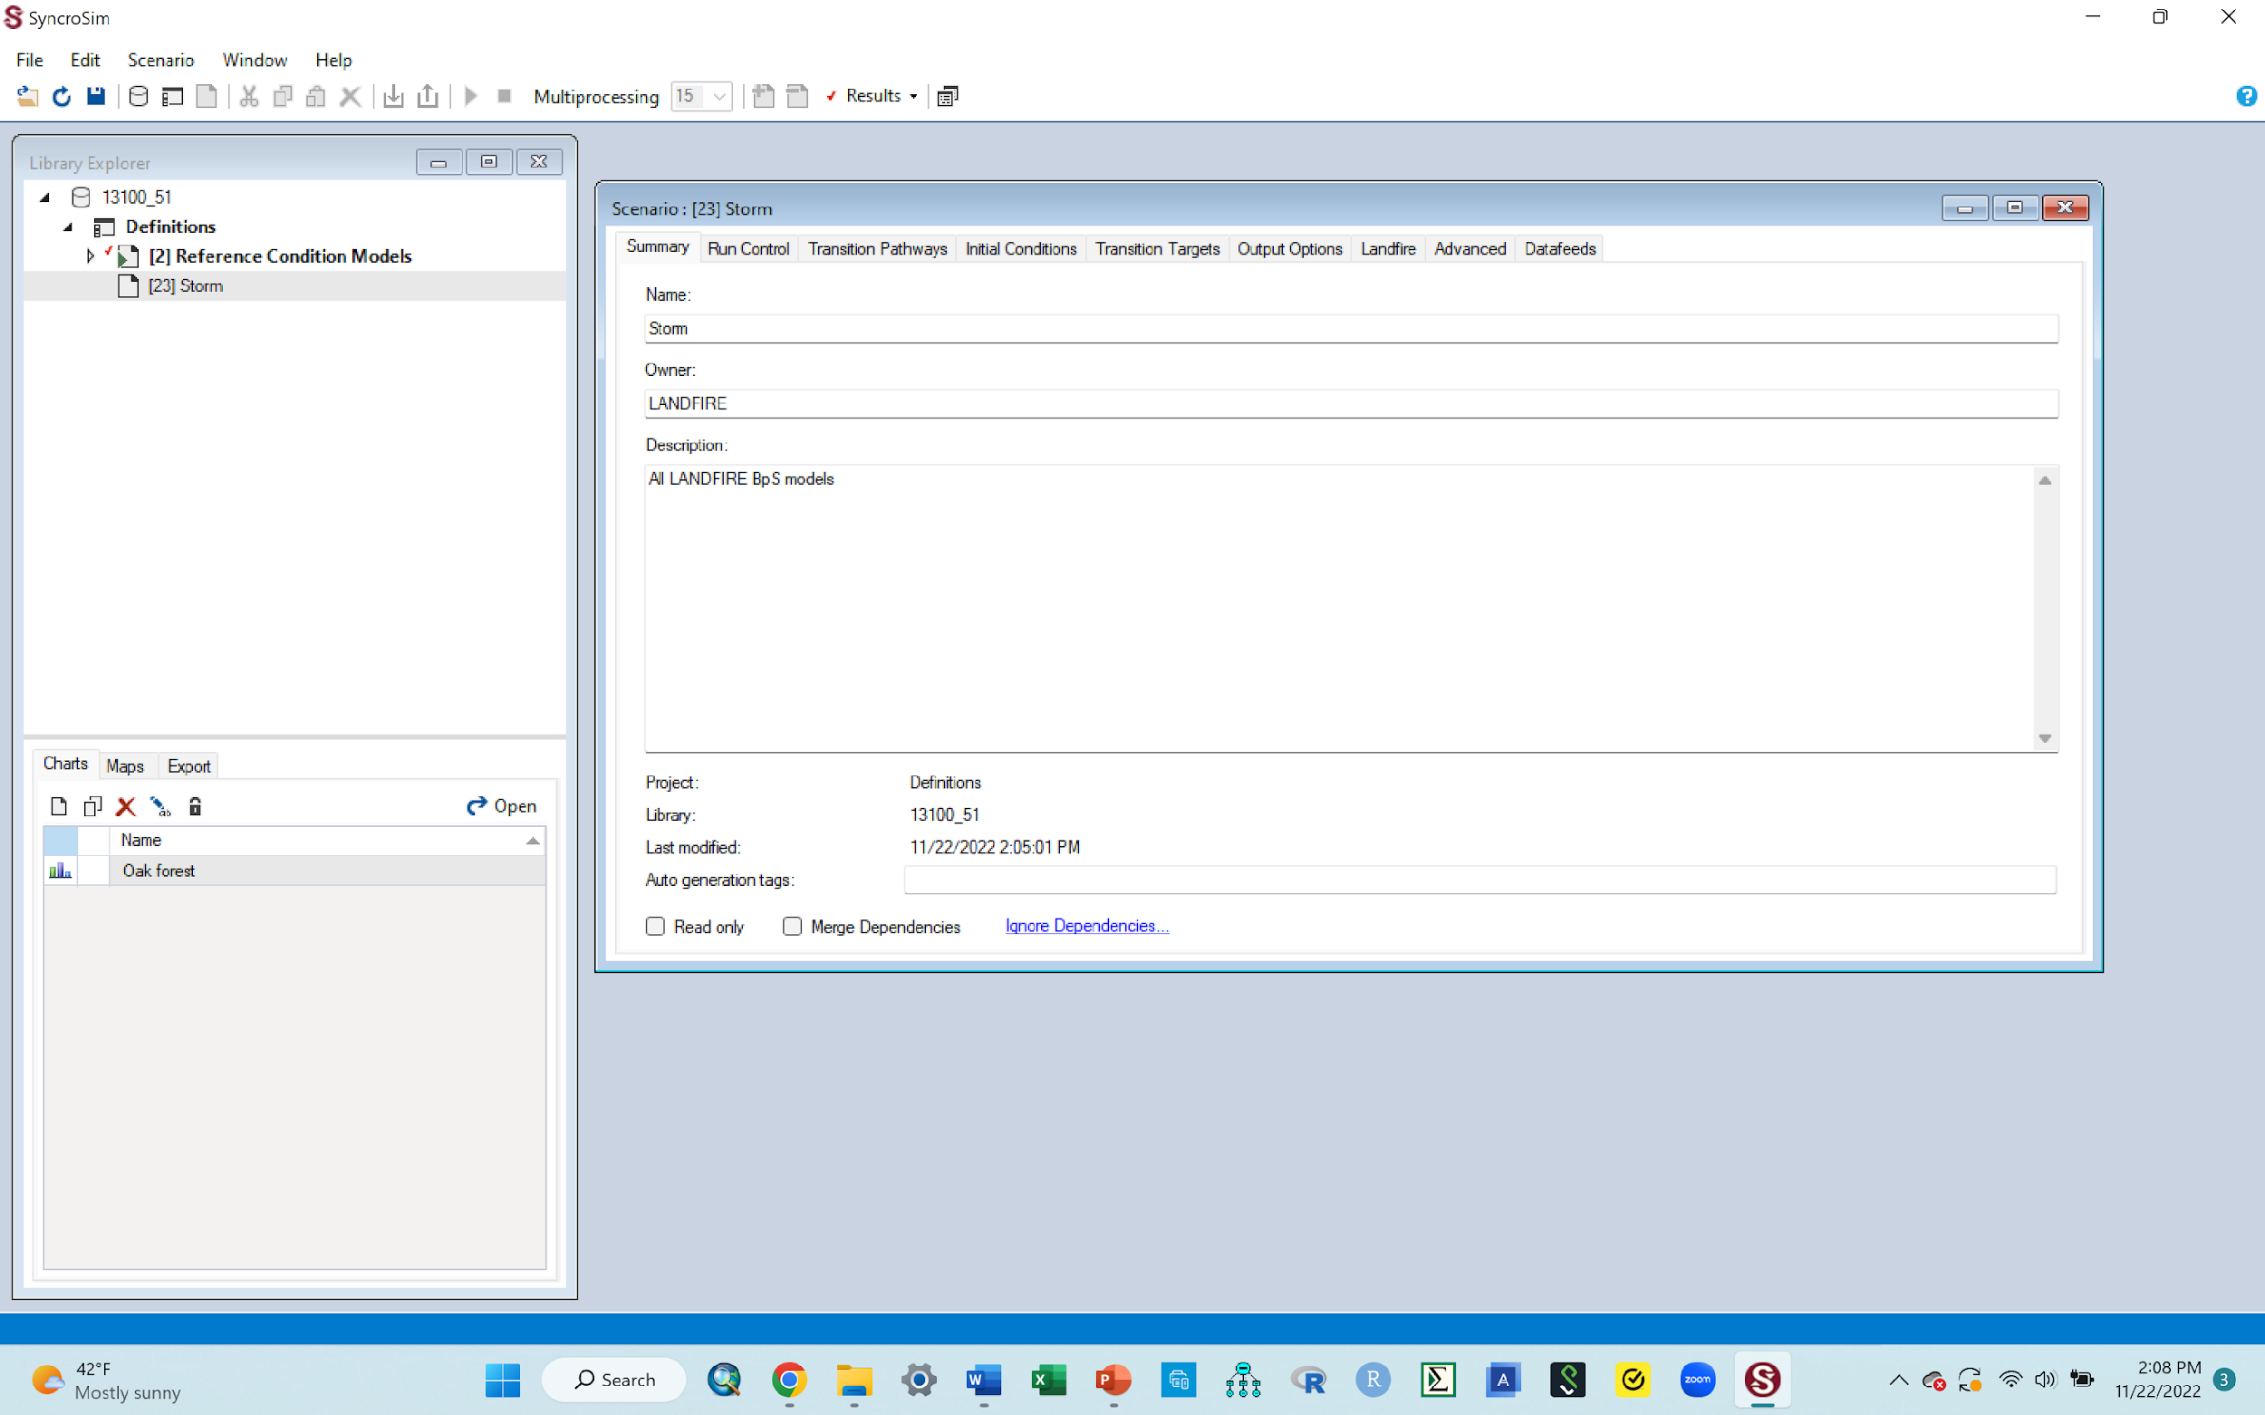
O. Introducing a disturbance
First, open the scenario pane for the Storm scenario
Double click the “Storm” scenario and that should bring up the scenario pane, similar to the one shown below
Remember: you can drag the pane to the right so it is right next to the library pane, and you can extend the pane downwards so it is larger
Your screen should look similar to the one below when done
Go to the next slide to continue

Slide 39
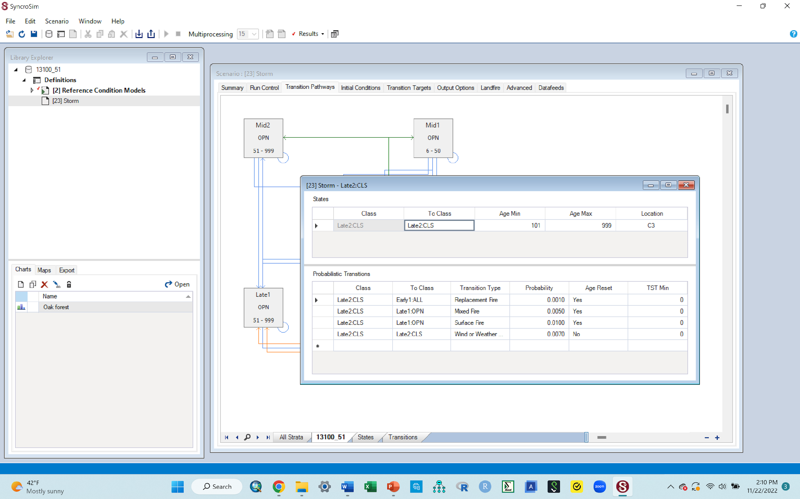
O. Introducing a disturbance
Next, you want to change the details of the “Transition pathways” diagram using its probabilistic transition table (a table that you can edit)
Click the “Transition pathways” tab to display the diagram of the state classes
Within the diagram, double click the box for “Late 2 CLS”. This will bring up a probabilistic transitions table (the little table shown in the image below that’s on top of the pathways diagram)
You are clicking this state class (Late 2 CLS) because when introducing a new disturbance, you click the state class(successional stage) that you want your disturbance to move the system from.
E.g., if moving the system from Mid 2 OPN to early 1 All, to get the table, you double click Mid 2 OPN in the transition pathways diagram
In this case, you want the disturbance to move this ecosystem from Late 1 CLS to something else, so you double click Late 1 CLS, i.e., the one you are moving it from.
Your screen should look similar to the one shown below
Go to next slide to continue

Slide 40
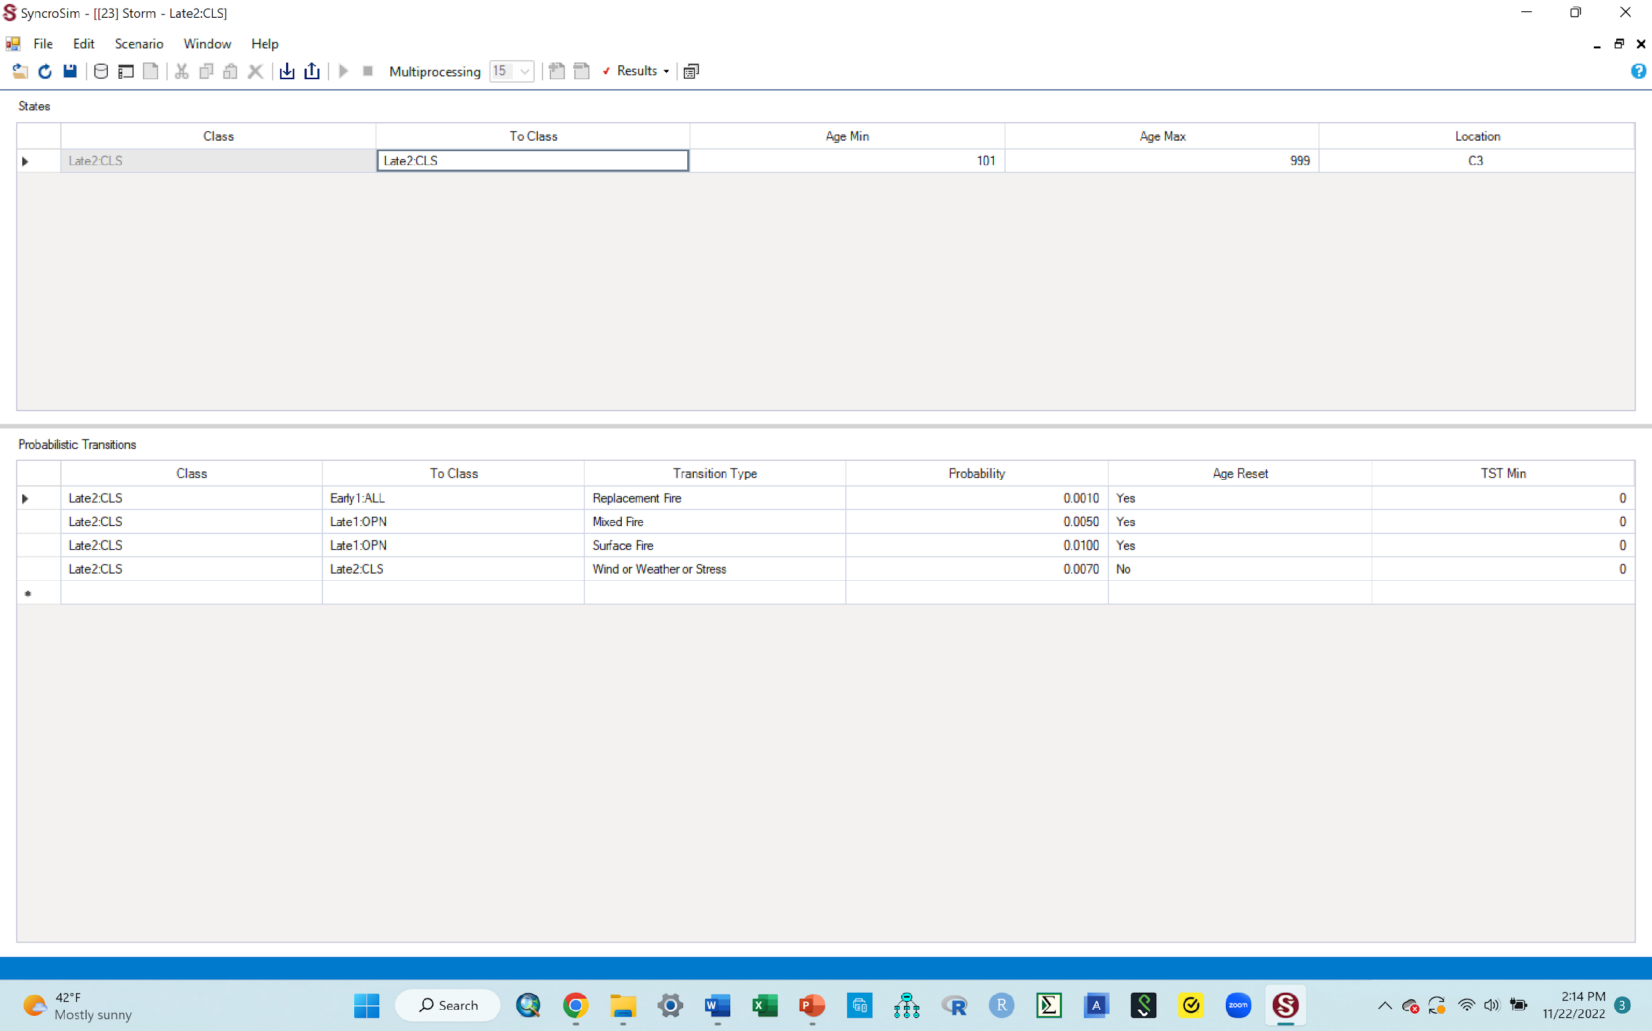
O. Introducing a disturbance
Next, you want to set up the characteristics of your new disturbance in the probabilistic transitions table you just brought up in the previous step
Maximize the table by clicking the little box at the top right corner next to the red X button. This will help you see the content of this table better
When done maximizing, your screen should look similar to the one below.
Go to next slide to continue

Slide 41
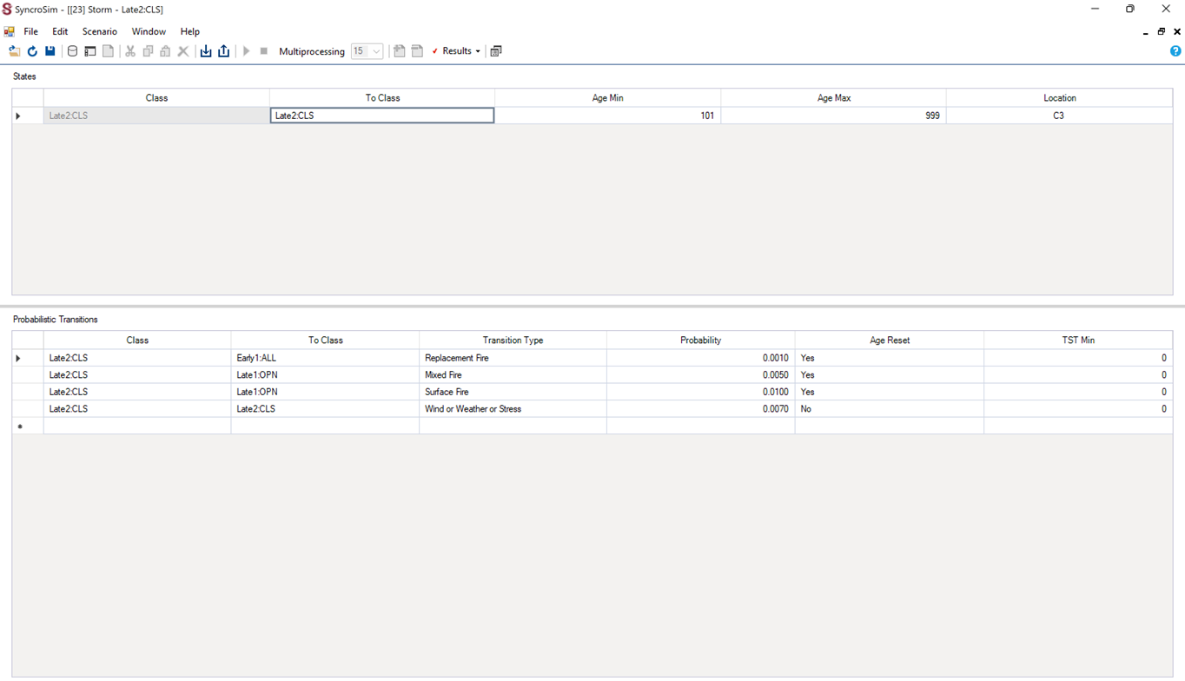
O. Introducing a disturbance
Within this table, there are two sections; the top section (labeled A below) and the bottom section (labeled B below)
For purposes of this activity, you want to leave the top section (labeled A) alone, so do not change anything in this section. You only want to make changes in the bottom section only (labeled B)
Go to next slide for steps to make these changes
A
B

Slide 42
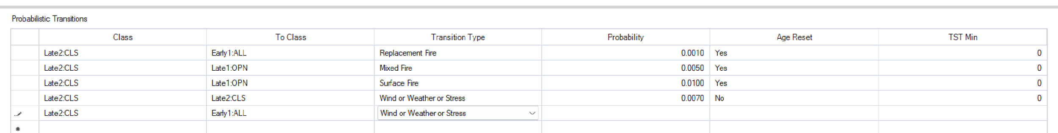
O. Introducing a disturbance
In section B of the table, click the first empty cell at the end of the ones with text in them under the column for “class”, and it will automatically fill that box in with Late 2 CLS. Once it does that, leave it as is.
Next, the cell in the “to class” column will already be filled. Click this cell and it will show a dropdown arrow to the right of that box. Click this dropdown arrow and among the classes shown, select “Early1 All”.
You are telling the model that you want the disturbance to impact the system in such a way that Late 2 closed succession stage will be reduced (move from), and instead the disturbance should provide opportunity for increase in early 1 succession stage that has a mixed canopy structure (move to).
This like saying that you are asking the disturbance to specifically target moving the ecosystem more from late 1 closed to more of early 1 All, even though you know that all the other classes are likely to be impacted as well during this process. You are telling the disturbance what you want it to target, even though disturbances will do that plus all the other things it wants to do in that ecosystem.
Under the “transition type” column, click the empty cell, then click the dropdown menu in it, and then select “Wind/weather/stress”. This means that, out of the types of disturbances given in that list, this is the category you have determined that best represents the disturbance (storm) that you are introducing into this ecosystem.
When done, your table should look similar to the one below, so far.
Keep going with your table on the next slide

Slide 43
O. Introducing a disturbance
Under “probability” column, type in 0.2000.
This sets the disturbance return interval. You are saying that you expect the storm to be returning to this ecosystem every 5 yrs. So, in probability terms, you divide 1 by the 5 to get 0.2000 that you put in this box.
This means that for any disturbance you work with, you need to know its return interval in yrs then use that number to calculate the probability for it, which is what you enter in this box (e.g., if return interval is say 10 yrs, you divide 1 by 10 to get 0.1000, which is what is entered in your table. Probability is always in decimal form so you must change your interval yrs (10 yrs) into a decimal format (0.1000)
For the “Age reset” column, click the cell and select Yes.
You are saying that you want the disturbance to reset the ecosystem to the lowest number in the age range of the class it is being moved to. In this case, because you are moving it to early 1 all (a stage that lasts 0 to 5 yrs), by clicking Yes on age reset, you are asking for the ecosystem to go back to 0 (the lowest number in the 0 - 5 age range)
For each disturbance you work with, you will have to decide if you want the system to reset age or not
Your table should have only the above columns: Class, To class, Transition type, Probability, and Age reset. If your table happens to have more classes (e.g., TSTMin), you can just fill in those extra classes with values similar to the ones above them. For example, if sayTSTMin has zeros in rows above the line you are working with, just put zero as well in your row.
Go to next slide to see your completely filled in table.

Slide 44
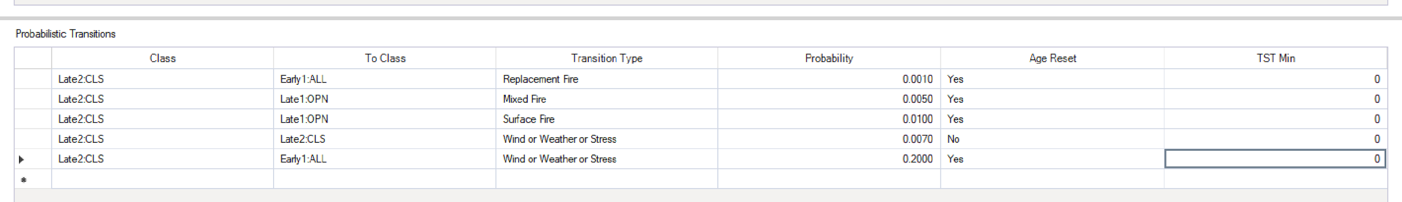
O. Introducing a disturbance
You should now have the table filled out, similar to the one below
Click the save icon at the top left corner of this page to save your work.
Do not leave this part without saving, you will lose all of the things you have told this model to do!
Go to next slide for instruction on how to exit this table

Slide 45
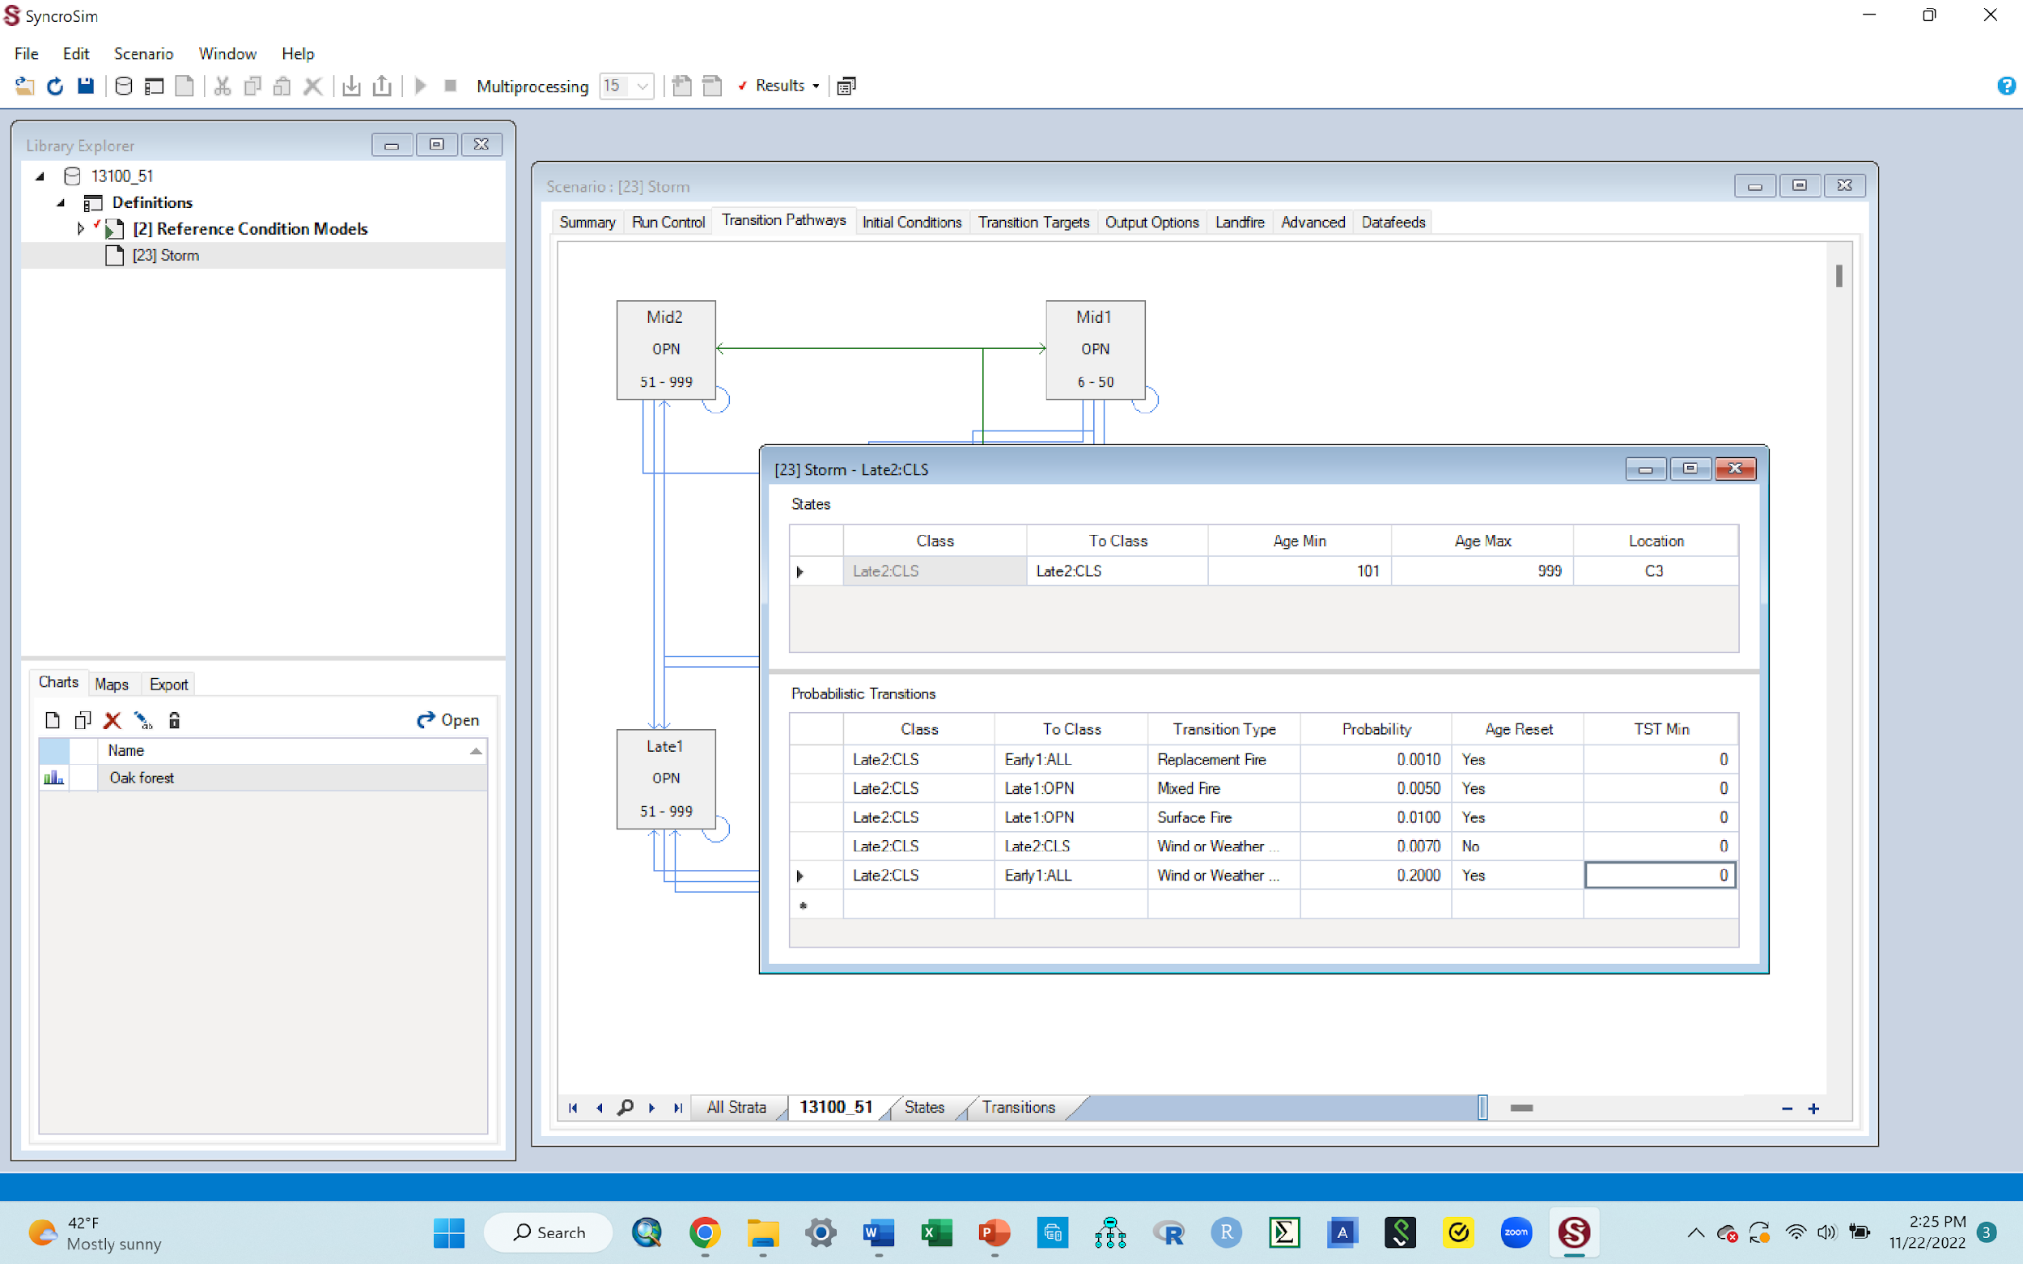
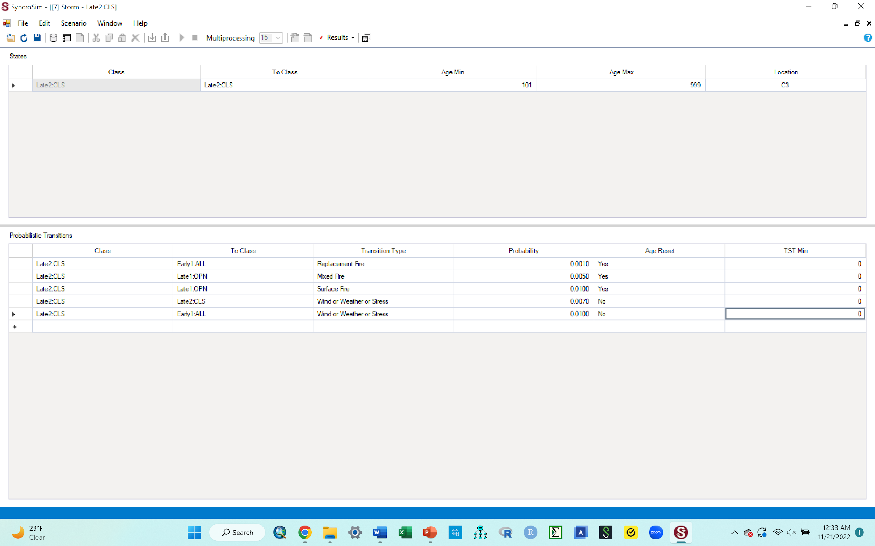
O. Introducing a disturbance
Now we want to exit out of the editable/probabilistic table so we can run the model
After saving, first minimize the table by clicking the middle set of boxes in the top right corner (shown in red box in the first image below). You need to do this minimizing step to avoid clicking the wrong tab that could delete your whole work window!
That will bring you back to the table and the pathways diagram as before (2nd image to the right)
To exit the table, click on the red X tab to its right corner.
That will leave you with the scenario pane that has the transition pathways diagram
Click save again and them click the red X tab on the top right hand corner of this pane to exit it as well
Go to next slide to see what you have now

Slide 46

O. Introducing a disturbance.
Your workspace should look similar to the one below after exiting the table and the scenario pane in the previous step

Slide 47
O. Introducing a disturbance
Now you want to run the model, just like you did before, to enable us to get a new graph
Click the “storm” library once to highlight it, Right click then select the green “Run” option, just like you did before.
A run monitor window will pop up to show progress and it could fast, Just like before
When done, get out of that run monitor window to remove it by using the red X button on the top right corner of that window, just like you did before
Check to ensure that under the “results” of your storm library, there is only one line of results. Delete any extra ones if you have more than one; the last one is the right one
Go to next slide to produce a new graph showing what your disturbance did to the successional classes

Slide 48
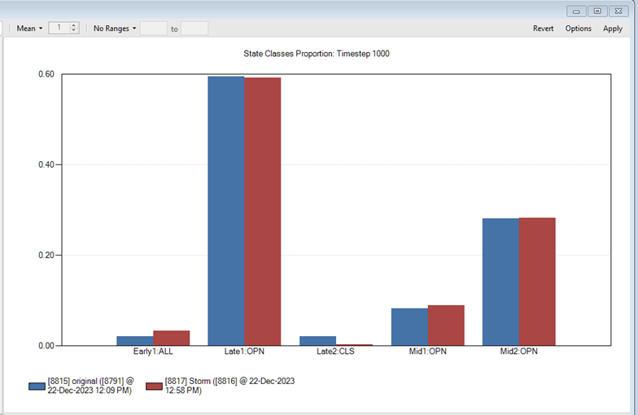
P. Finally, produce a graph of results for you storm disturbance
Produce a new graph just like you did previously
Double click the “oak forest” chart, and out should pop a new graph!
This graph should have two bars for each state class. Blue and red
It shows you the proportion of the ecosystem that is made up of each state class (succession stage) before the disturbance (the blue bars) and after the disturbance (the red bars)
The blue bars are the original bars you had in the first graph you made. These should never change since it is our baseline
The red bars represent the new classification of successional stages, based on the result of the disturbance you introduced. Go to the next slide to copy your graph to your word doc

Slide 49
Graph, yaay!!
Assignment # 3: Put the cursor in the middle of the graph, right click, select “copy to clipboard”, then paste in your word doc. Caption this graph as Figure 3. Storm
If you run into problems while producing this new graph or the graph itself does not look right as it should be in terms of bars, go to the next slide for suggested solutions.
If you graph worked out ok and you did not run into any issues producing it or the graph itself has the correct content in terms of bars, ignore the next slide and go to the one after it.

Slide 50
Q. Problem you may run into with your new graph
Sometimes, your new graph that pops up may have only 1 bar for each successional stage. If this happens
click the save tab and exit the new graph
click the scenario for the disturbance you are working with to highlight it (e.g., storm)
run it again
then come back and double click the “oak forest” chart
This should refresh your graph to show 2 bars per successional stage
Other times, you may get a graph with two bars alright, but the results just do not seem like what you should get, or you are just suspicious. To address this, you can change the parameters you had entered in the editable table (probabilistic table) and rerun the model for that scenario.
Click the dropdown on your scenario (e.g., storm) to bring up the “results” line
Right click this results line and delete it
Double click the storm scenario to bring up the editable table where you had put the parameters of your disturbance into before.
In the section where you had entered things before (section B), the line/row that you entered ddata in before will not be there anymore since you deleted results. You need to use the first empty cell at the end of the ones with data in them to again enter your parameters, just like you did before, but with whatever new parameters you want to use
You could for example change the return interval, so now instead of using 5 yrs, you use 10. Use that to calculate the probability that you enter in the probability column.
You could change your choice for age reset or transition type, whatever makes sense to change. Typically, changing the value you put in the probability column (your return interval value) is sufficient to result in meaningful change, without needing to change parameters in the other columns.
Click Save, exit the table, rerun the scenario. You must rerun the model after changing parameter in the table, otherwise you will get the same results you had before
Once completed, exit the run box, and double click the chart to display your new graph

Slide 51
R. Reminder explanations about what you are doing (knowledge cementing)
Using these two bars in the graph, you are looking to see what the disturbance did to this ecosystem.
The impact could be that the disturbance reduced or increased any of the successional stages.
Ecologically, you expect a disturbances to change something/have an impact, right?
There are various ways to examine such an impact, right?
In this activity, you are examining that impact by looking at the changes it made to the succession stages e.g., did it reduce later 1 closed and increase early 1 all? What did it do to the other succession classes?
That is how you use modeling to introduce a hypothetical disturbance to an ecosystem, and then see what that disturbance will do to that ecosystem, as mentioned before. In this case, you are examining this change by looking at what the disturbance does to the differennt succession classes
Later on (with new disturbance that you will do), you will be asked to explain what you think happened that made the vegetation/ecosystem change the way that it did e.g., why do you think mid 1 closed decreased while mid 2 open increased? What could the disturbance have done to the vegetation to make this change happen?
Explanations continue in next slide

Slide 52
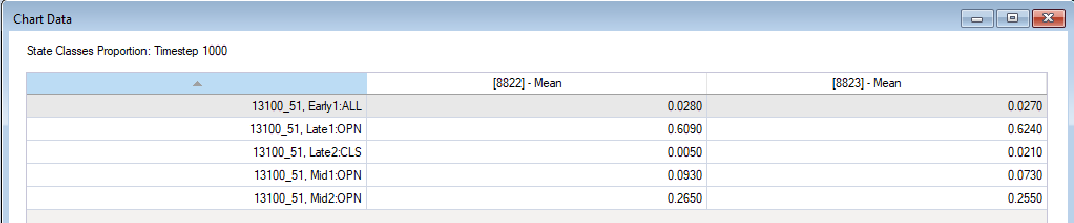
R. What if I would like to see the changes, in numbers, not just by looking at the bar heights?
To view the level of change for each succession stage in terms of numbers, do the following
While you have the graph up, put your cursor over any of the bars, right click and click “view data” in the selections given. This will give you a table similar to the one below, where you can see what the values were for your original scenario (the 8822) and what the values are for your disturbance scenario (the 8823)
You can also put your cursor over any of the bars, right click and select “export”. This will export the numbers for both the original scenario and the disturbance scenario into an excel file, in case you want to make graphs by yourself later. Just note that the activity you are doing right now not require you to export anything; the graph you made during this process is sufficient.
Now that you have just modeled the impact of a storm as a disturbance, in the next section, you are going to model some additional disturbances

Slide 53
Part 3: Modeling the impact of other disturbances on this ecosystem, using the steps learned with the storm practice disturbance

Slide 54
You would now like to model other disturbances using the steps you just learned with the storm disturbance
Note
Do not delete the “[2]Reference condition models” scenario or its results, that has you original succession classes (blue bars) in the results and those need to show up as part of any new disturbance graph you make.
Do not run the original model (“[2]Reference condition models”) again. At this point, you should not need to run it again!. As long as you leave it in place, it retains the first run you made on it and its results, so your original blue bars should still show up in the new graphs that you will make. If for some reason you delete it, you must run it again so you can have your original blue bars, before doing your next disturbance
Delete the storm scenario before starting your next disturbance. Too many scenarios (for multiple disturbances) in your workspace can make you copy the wrong scenario when creating a new disturbance. Always delete the scenario (disturbance) you are done with, before creating a new one.
Use the instructions given in the “additional disturbance” supplemental material to model additional disturbances and answer questions for each.
Follow assignment instructions given by your instructor to turn in the required assignments for this activity. This will be the word document where you paste all your graphs and respond to all questions given

